Slide 1
How do we measure/report success indicators for the Framework and Action Plan
Jon Hunter (Scottish Government, CAD)

Slide 2
Strengthen Scotland’s Equality Evidence Base
Equality Evidence Finder web resource (Relaunched today!)
Scotland’s Equality Evidence Strategy

Slide 3
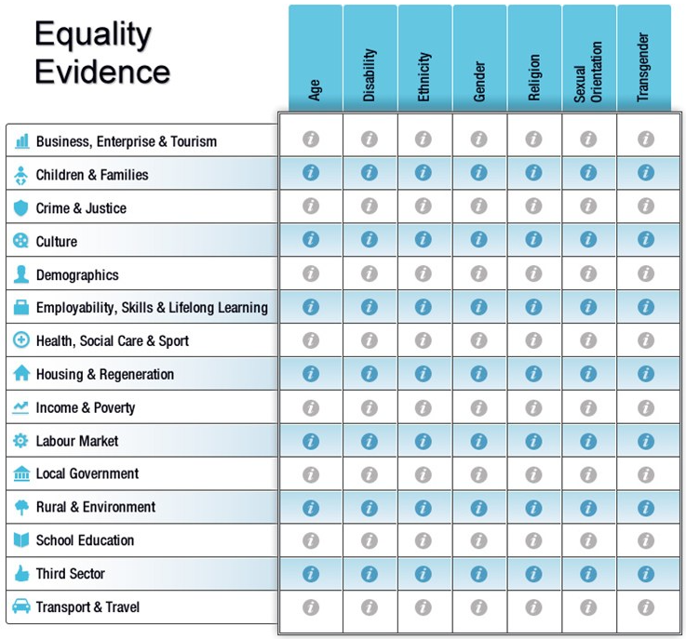
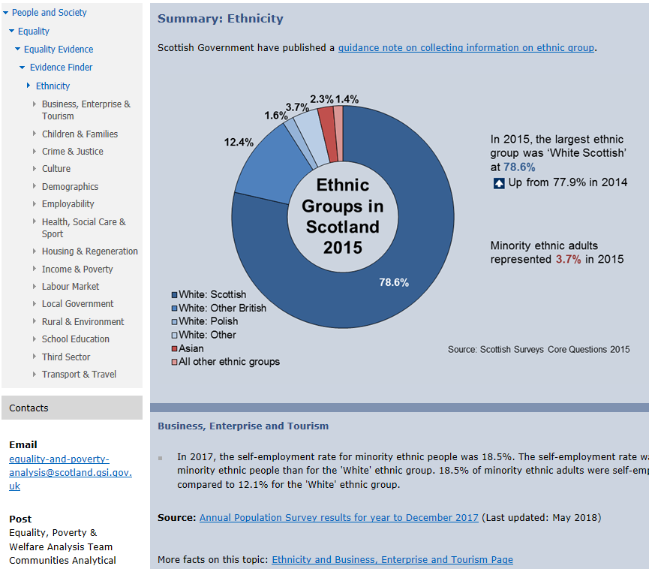

Slide 4






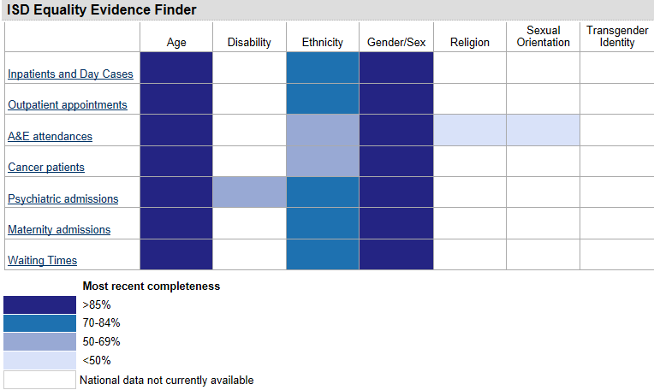


6

Slide 5
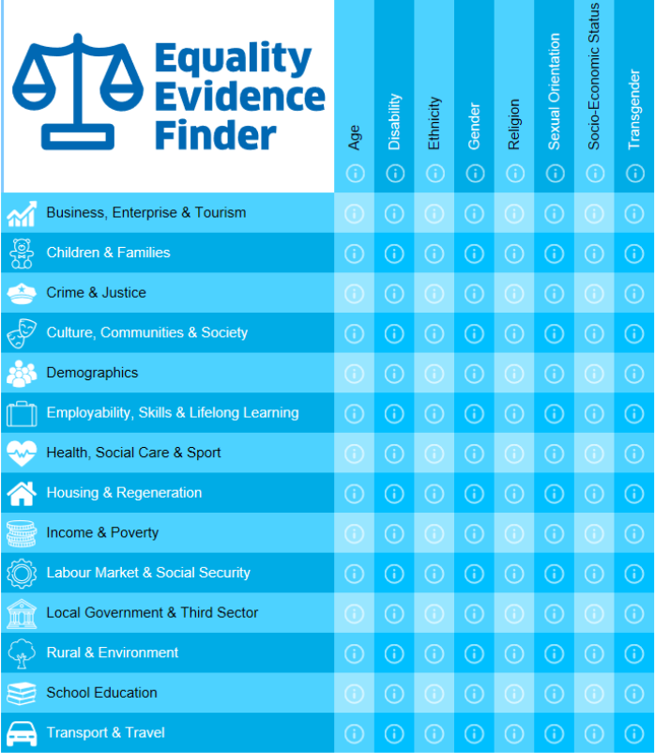

Slide 6
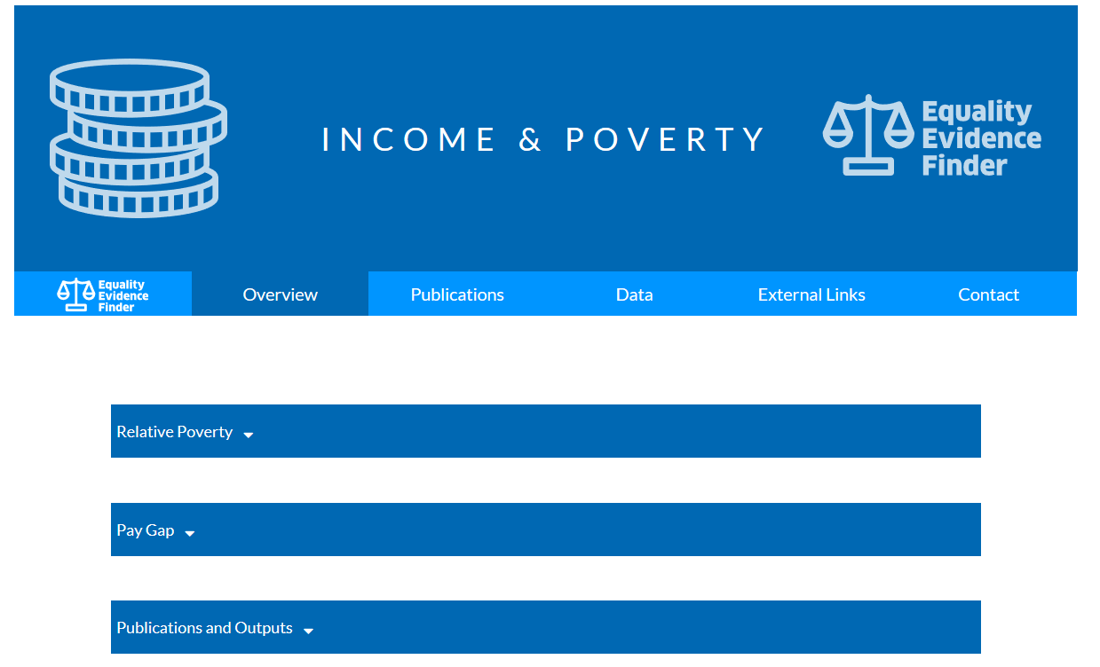
Topic sections
Publications section

Slide 7
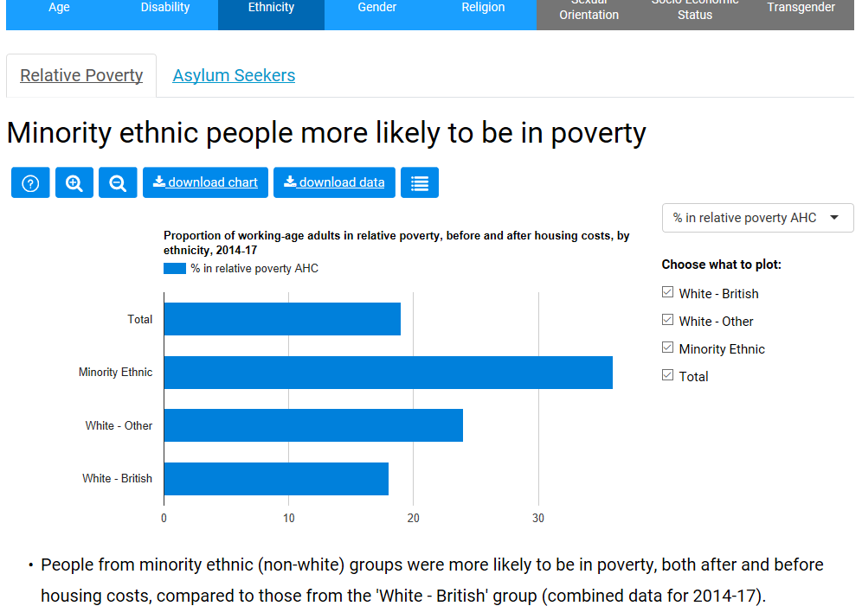
https://scotland.shinyapps.io/sg-equality-evidence-finder

Slide 8




Slide 9
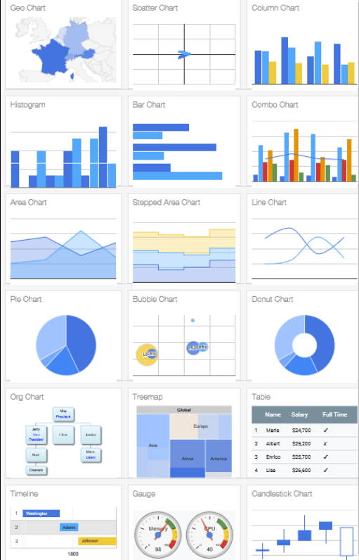

Slide 10

Improving Content and filling evidence gaps
Equality Evidence Strategy
A four year (2017-2021) plan to strengthen the equality evidence base

Slide 11
Future Plans
Launch the new Evidence Finder in December 2018 (today!).
https://scotland.shinyapps.io/sg-equality-evidence-finder
Seek feedback from users and make relevant tweaks and improve accessibility social-justice-analysis@gov.scot
Populate Socio-economic status column
Seek to strengthen links with the NPF
Improve content by continuing to fill evidence gaps, guided by the Equality Evidence Strategy

